Slide 1


RASO CONSTRUCTION & INTERIOR
Structural Plans
From plot planning and setbacks to engineered drawings and a structure built to last.

Slide 2
OUR PROCESS
From Plot to Structure
01
02
03
Site & Soil
Plot Planning
Load Calculation
Plot survey, soil investigation and safe bearing capacity for foundation design.
Setbacks, ground coverage, FAR and height as per the authority zonal plan.
Dead, live, wind and earthquake loads as per IS 875 and IS 1893.
04
05
06
Structural Design
Drawings & BBS
Execution
Footings, columns, beams and slabs designed as per IS 456.
Structural drawing set with reinforcement details and bar bending schedule.
Site supervision, quality checks and slab casting as per the drawings.
RASO Construction & Interior · Structural Plans
02

Slide 3
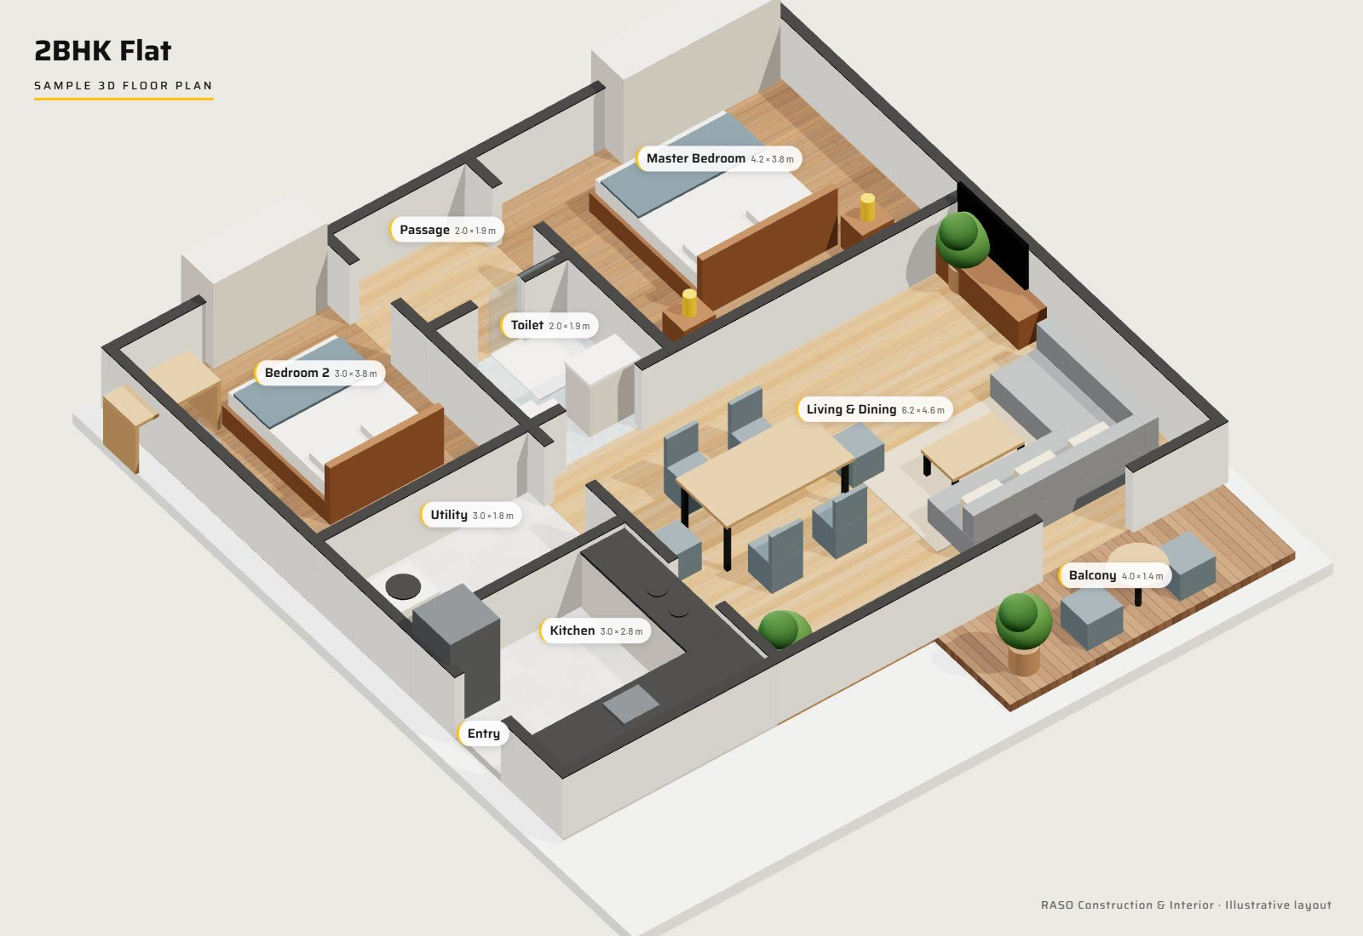
SAMPLE 3D FLOOR PLAN
2BHK Flat
Living & dining (6.2 × 4.6 m) opening onto a balcony
Two bedrooms with wardrobes and an attached toilet
Separate kitchen with utility area
Every room furnished to scale before construction begins
RASO Construction & Interior · Structural Plans
03

Slide 4
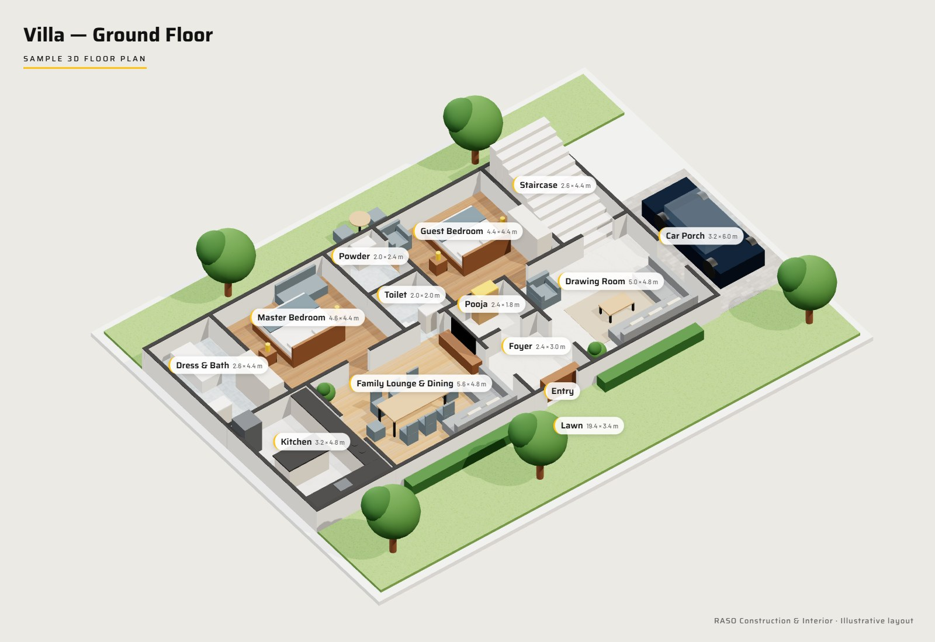
SAMPLE 3D FLOOR PLAN
Villa — Ground Floor
Drawing room, family lounge and dining
Master and guest bedrooms with attached baths
Pooja room, powder room and internal staircase
Car porch with front and back lawns
RASO Construction & Interior · Structural Plans
04

Slide 5
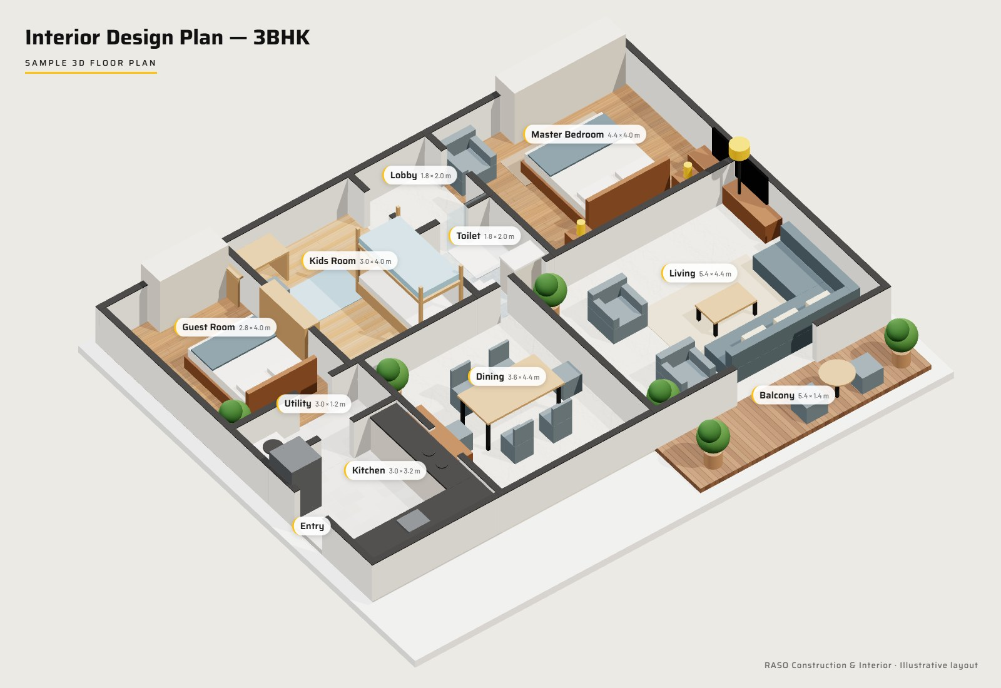
SAMPLE INTERIOR DESIGN PLAN
Interior Design — 3BHK
Room-by-room furniture layout to scale
Flooring finishes — marble, wood and anti-skid tile
Modular kitchen, wardrobes and storage planned in
Kids room with bunk bed and study corner
RASO Construction & Interior · Structural Plans
05

Slide 6
DELIVERABLES
The Structural Drawing Set
S-01
General notes & typical sections
S-06
Beam schedule & sections
S-02
Foundation & footing layout
S-07
Slab reinforcement — top & bottom
S-03
Footing sections & details
S-08
Staircase details
S-04
Column layout & schedule
S-09
Overhead water tank & septic tank
S-05
Plinth & floor beam layouts
S-10
Bar bending schedule (BBS)
RASO Construction & Interior · Structural Plans
06

Slide 7
COMPLIANCE
Designed to Indian Standards
IS 456
Plain & reinforced concrete — design of footings, columns, beams and slabs
IS 875
Design loads — dead, imposed and wind loads
IS 1893
Earthquake-resistant design for the site’s seismic zone
SP 34 / IS 2502
Reinforcement detailing and bar bending
NBC & bye-laws
National Building Code and local authority sanction rules
Structural drawings for sanction are prepared and signed by a qualified structural engineer.
RASO Construction & Interior · Structural Plans
07

Slide 8


ON SITE
From Drawing to Slab Casting
1000 m² site · ETA-01, Greater Noida — slab casting executed as per the structural drawings.
RASO Construction & Interior · Structural Plans
08

Slide 9
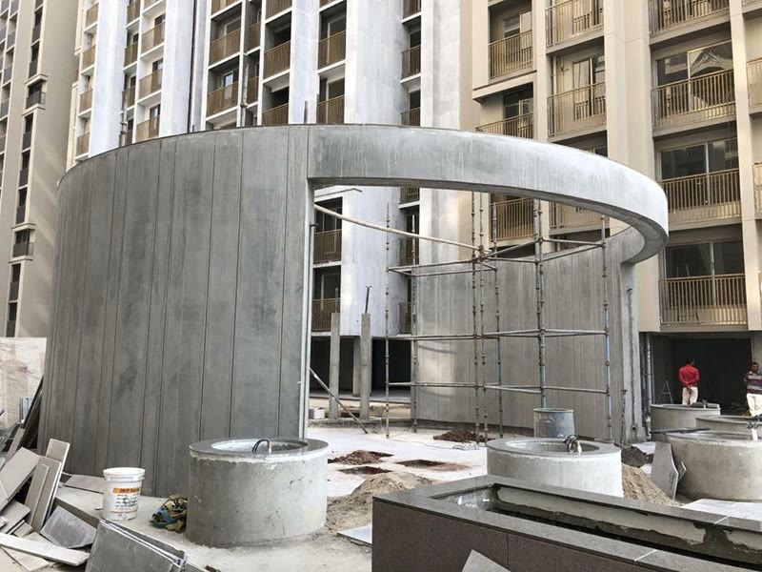
BUILT TO LAST
10-Year Structural Warranty
“
Raso Construction & Interiors provided excellent structure consultancy and planning for our home in Delhi NCR. Clear communication and timely updates.
Pradip Ubale, Google review
RASO Construction & Interior · Structural Plans
09

Slide 10

GET STARTED
Get Your Structural Plan
Share your plot size and location — our architects and engineers will guide you from planning to sanction and construction.
+91 99107 96100
raso.connectus@gmail.com
S-6, 7 & 8, Beta Plaza, Beta-1, Greater Noida – 201310
RASO Construction & Interior · Structural Plans
10

